Slide 1

WAY TO ENTERPRISE
AWS
VTI ACADEMY
Author: duy.nguyenngoc1@vti.com.vn

Slide 2
EC2 Service
Stands for Elastic Compute Cloud
Is a service to provide hardware (Ram, CPU, Storage), Network, OS System (Windows, Linux, Mac OS, ...), Software (SQL Server, ...), Firewall (Security Groups, ...), Bootstrap script, ...
Scaling
Computing Service
Regional service
Infrastructure as a Service

Slide 3
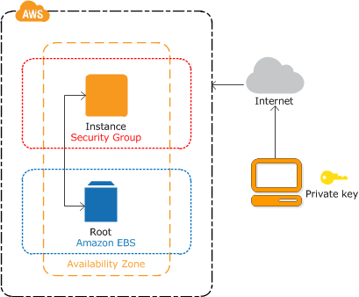
EC2 Service
Demo
Create key pair
Launch a Instance
Test website
Start / Stop / Reboot Instance
Turn on Termination Protection
Connect to Instance
Create Snapshot
https://docs.aws.amazon.com/AWSEC2/latest/UserGuide/EC2_GetStarted.html

Slide 4
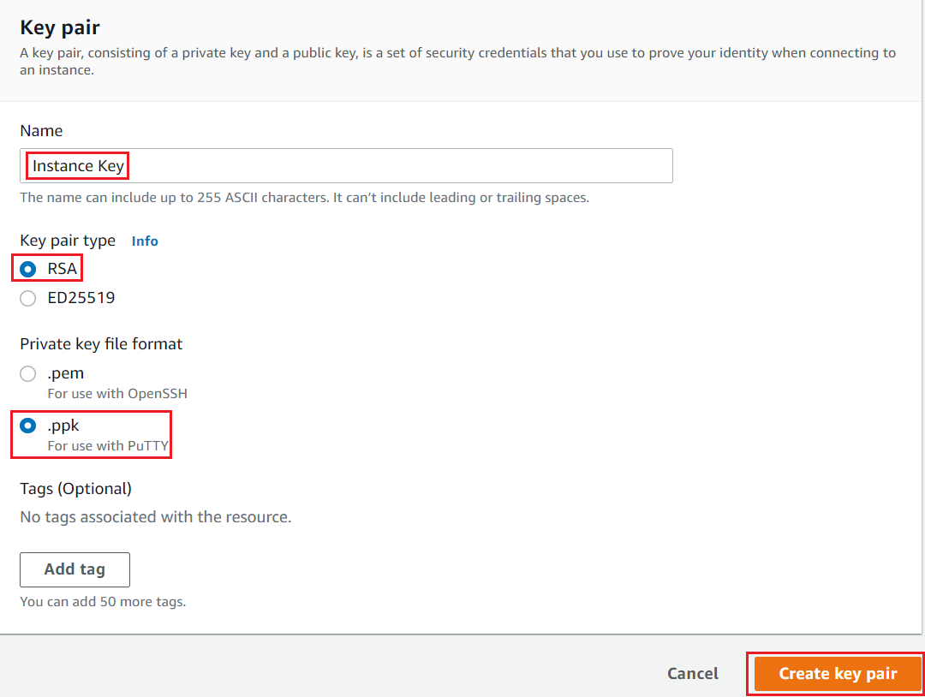
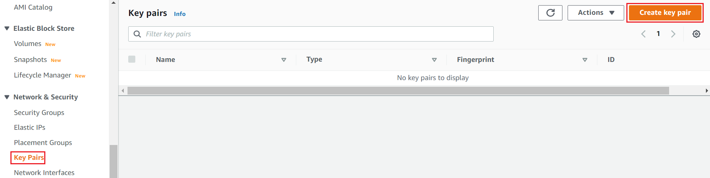
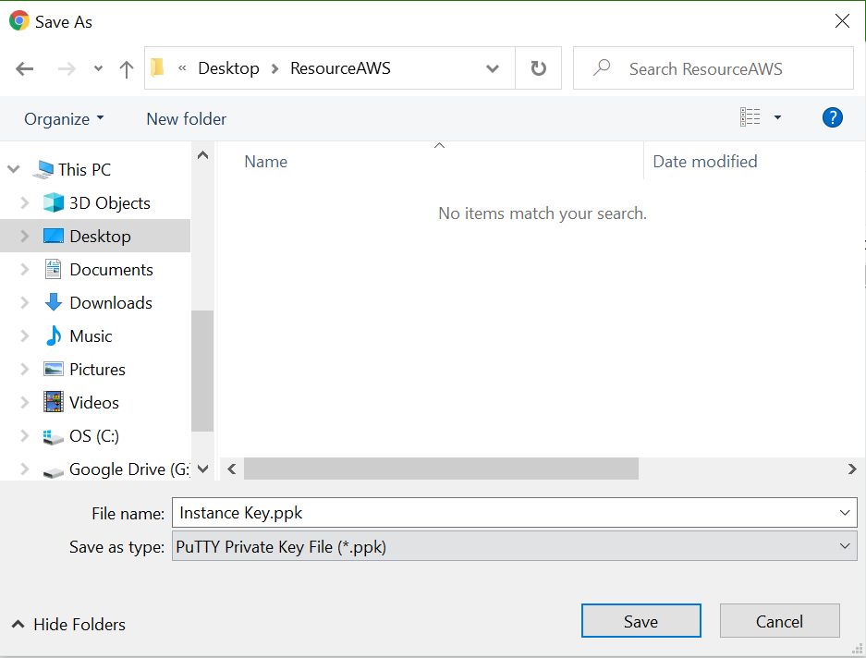
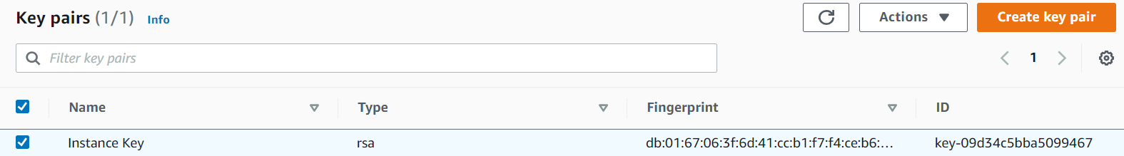
EC2 Service
Create key pair
Create Key Pair
Save Private Key
Result

Slide 5
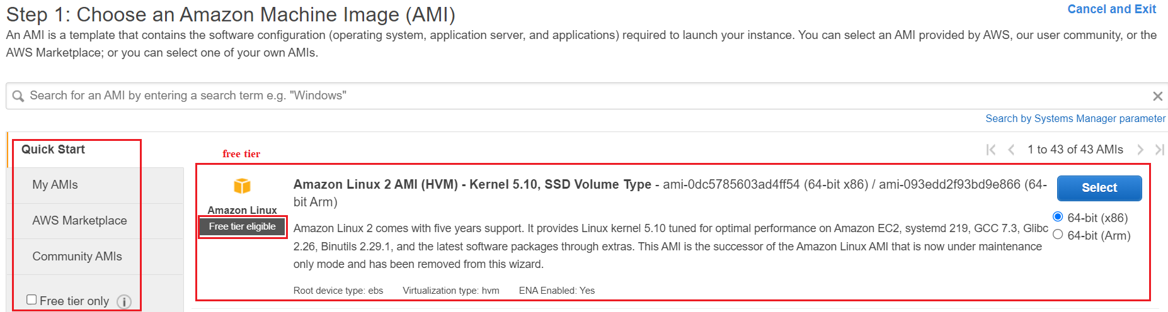
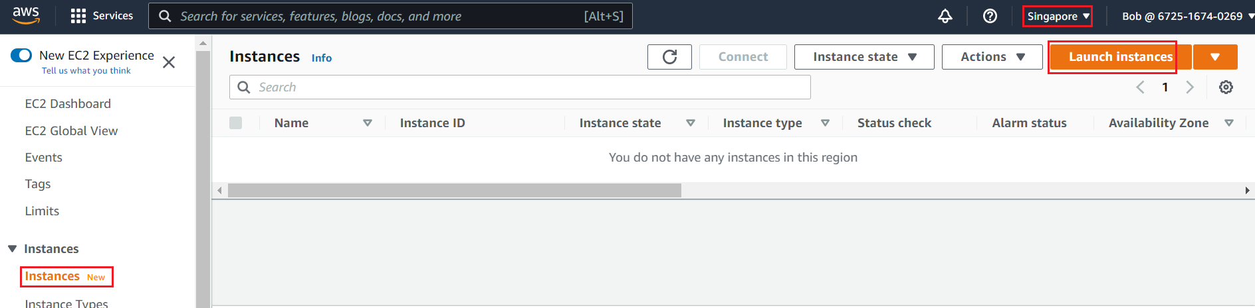
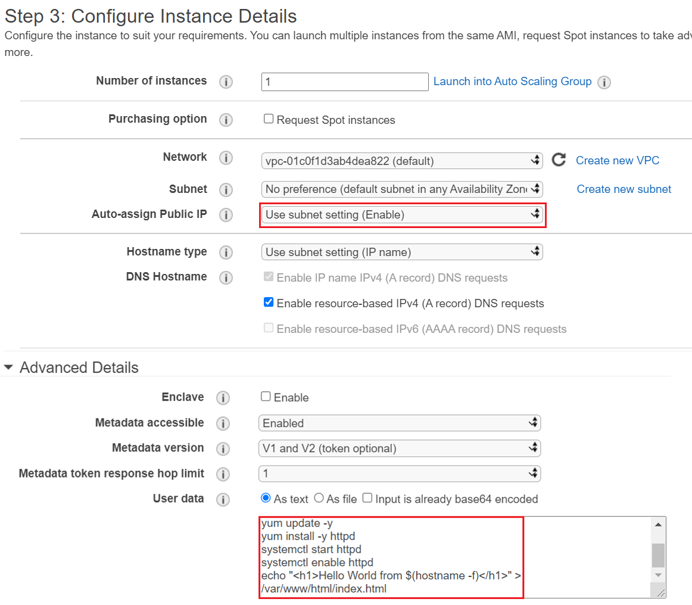
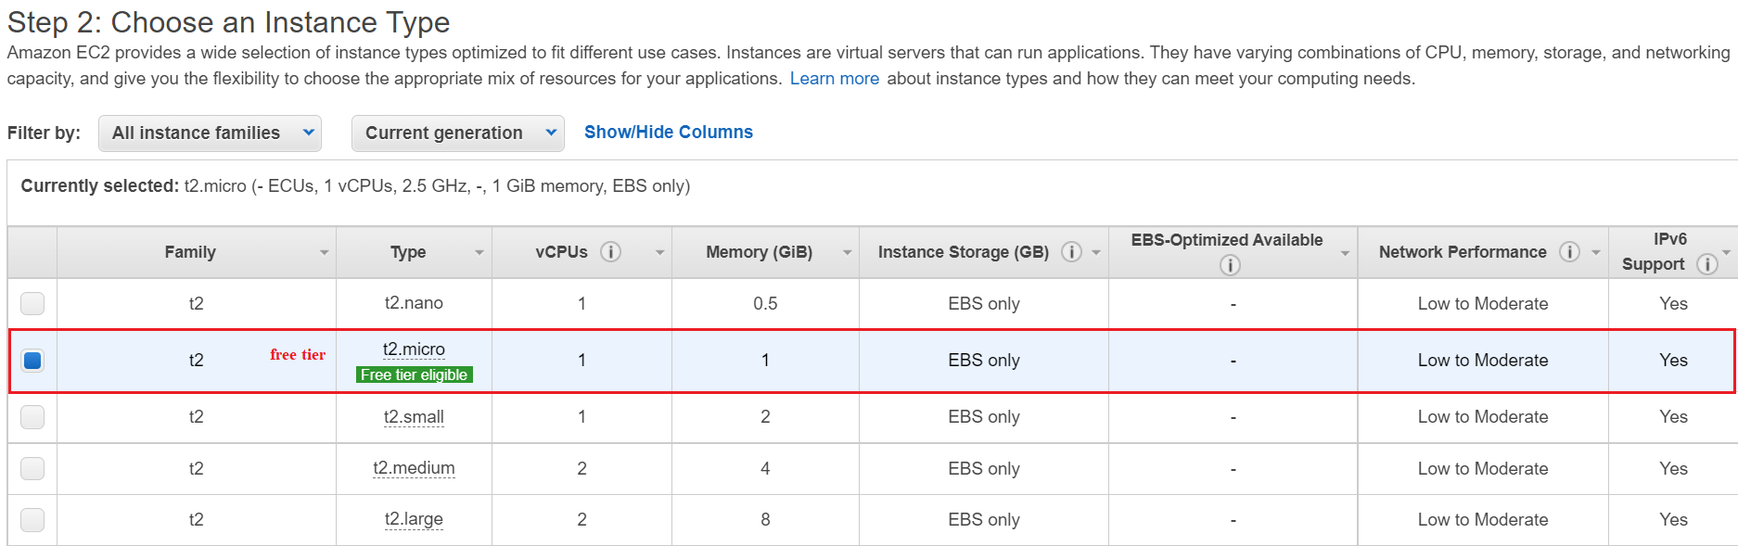
EC2 Service
Launch a Instance
Choose AMI
Choose Instance Type
Config Instance
https://docs.aws.amazon.com/AWSEC2/latest/UserGuide/EC2_GetStarted.html

Slide 6
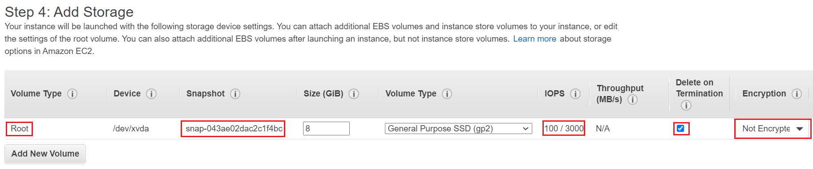
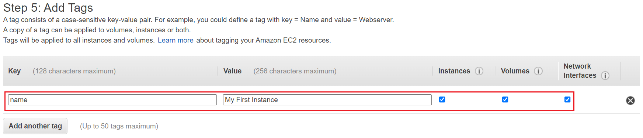
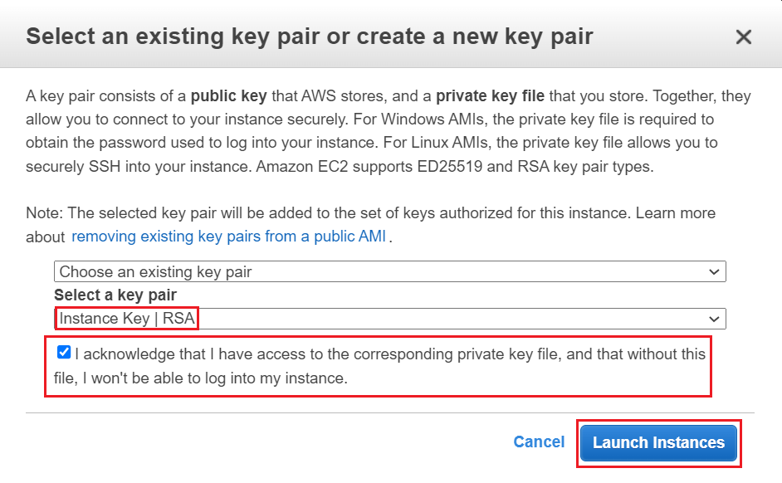
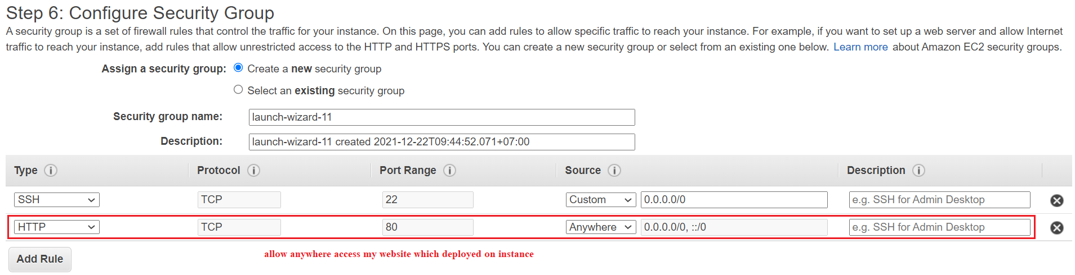
EC2 Service
Add Storage
Add Tag
Config Security Group
Choose Key Pair

Slide 7
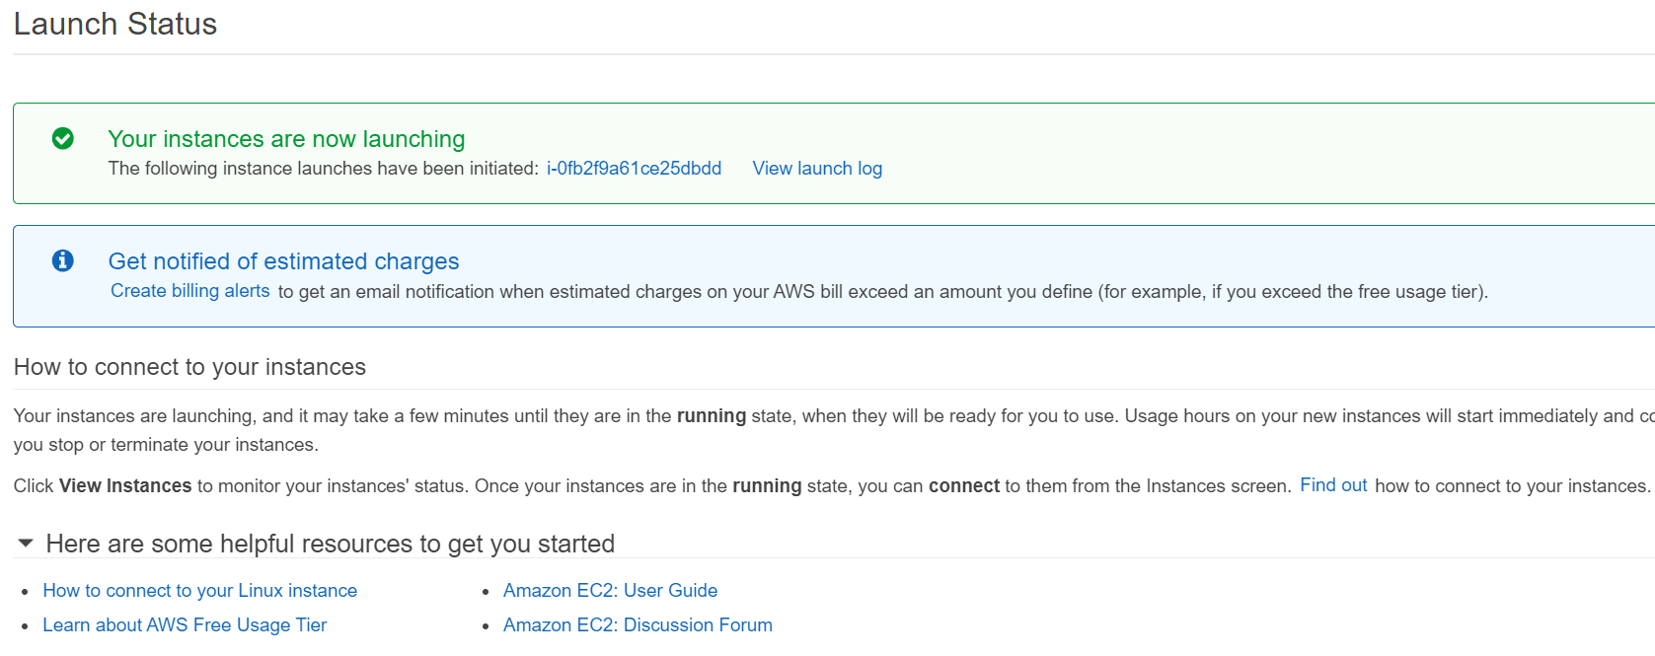
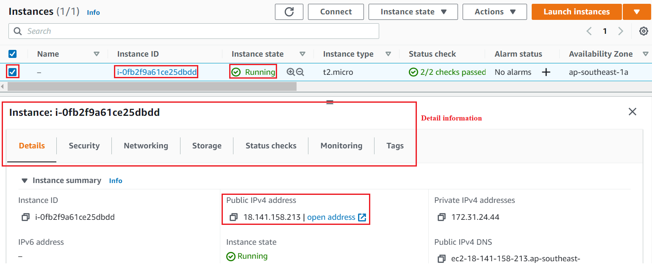
EC2 Service
Result

Slide 8
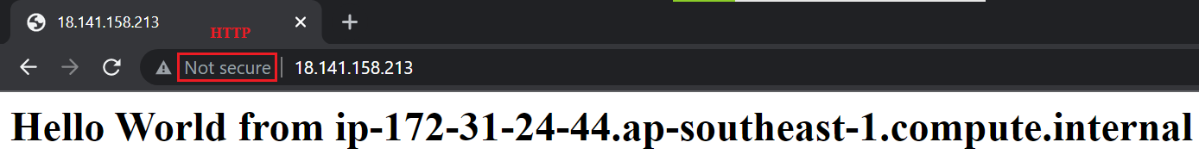
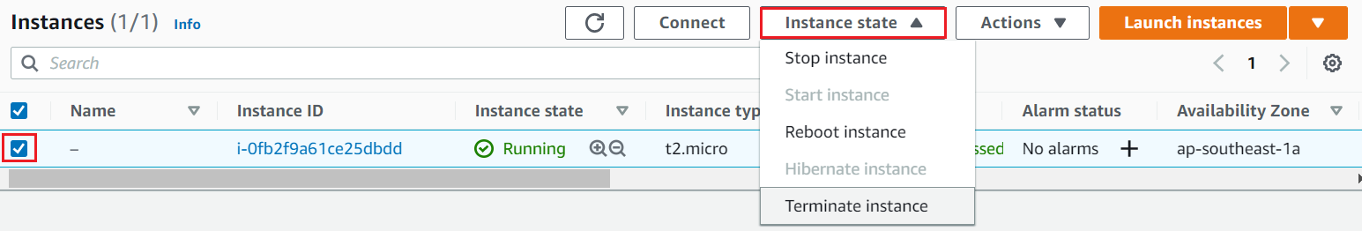
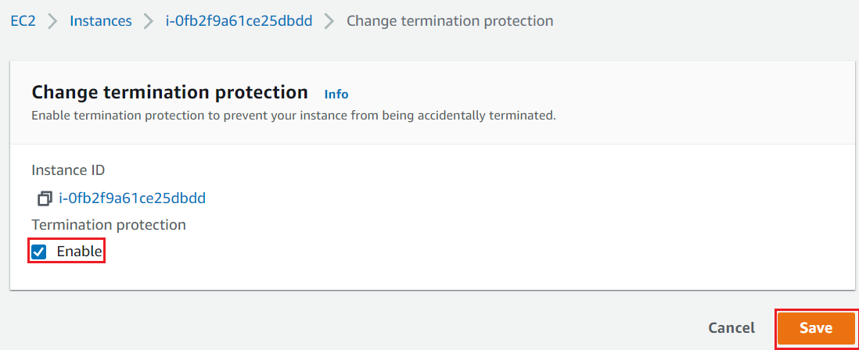
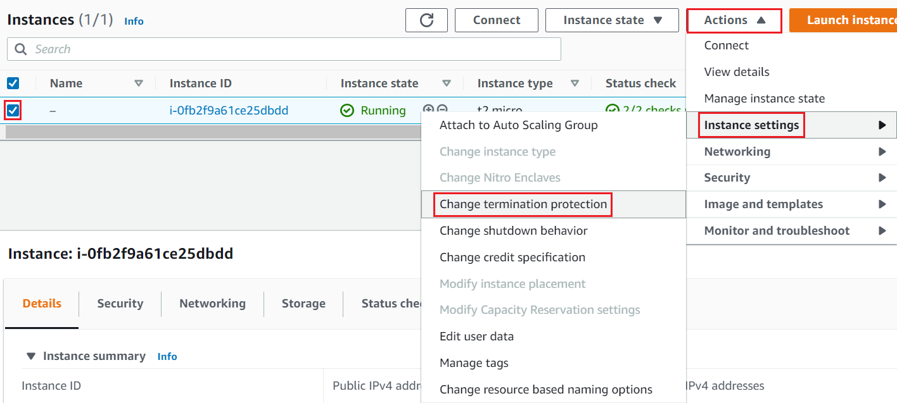
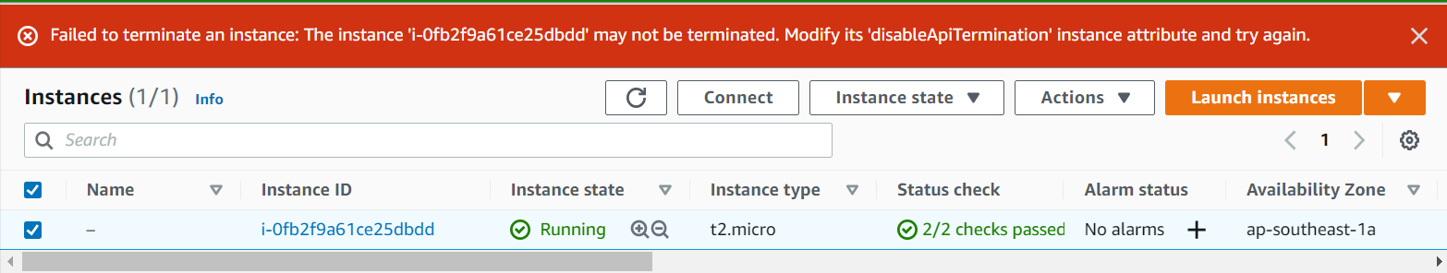
EC2 Service
Test Website
Start / Stop / Reboot / Hibernate / Terminate Instance
Turn on Termination Protection

Slide 9
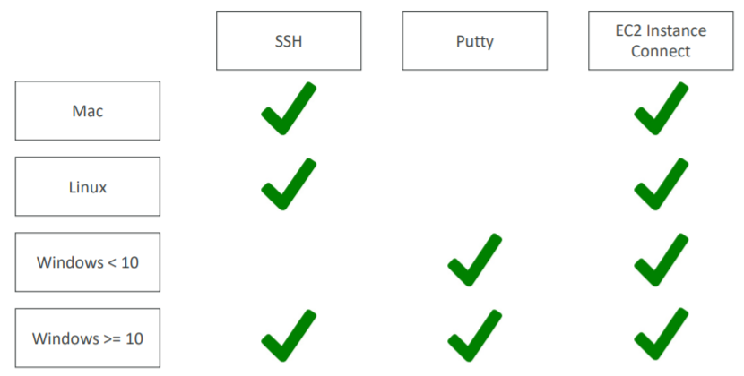
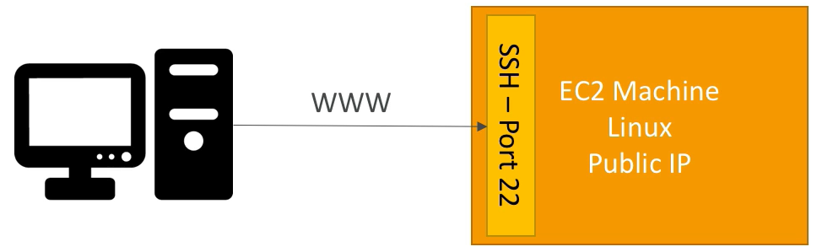
EC2 Service
Connect to Instance
SSH for Mac/Linux
Putty for Windows
EC2 Instance Connect for Console UI

Slide 10
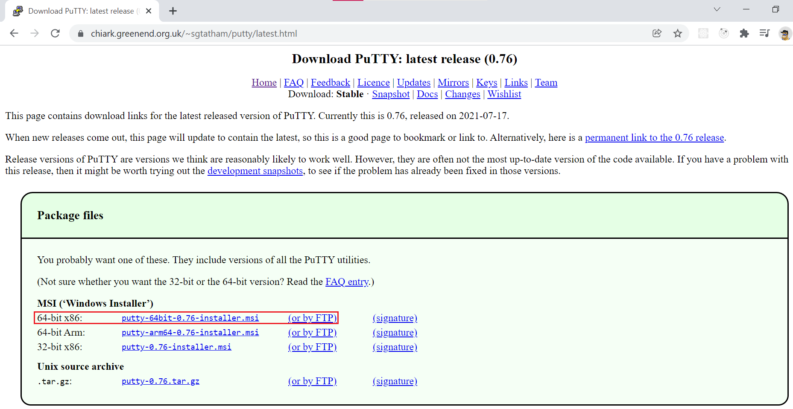
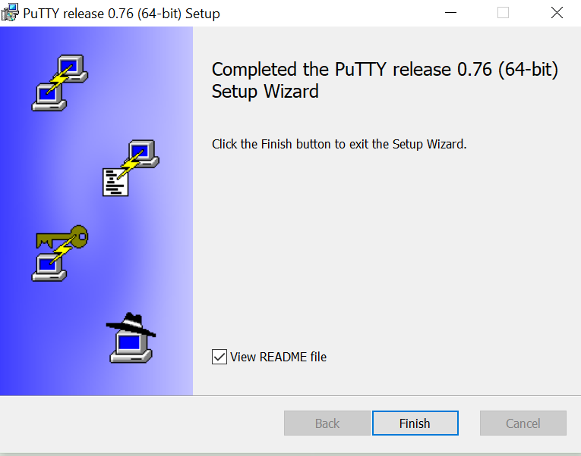
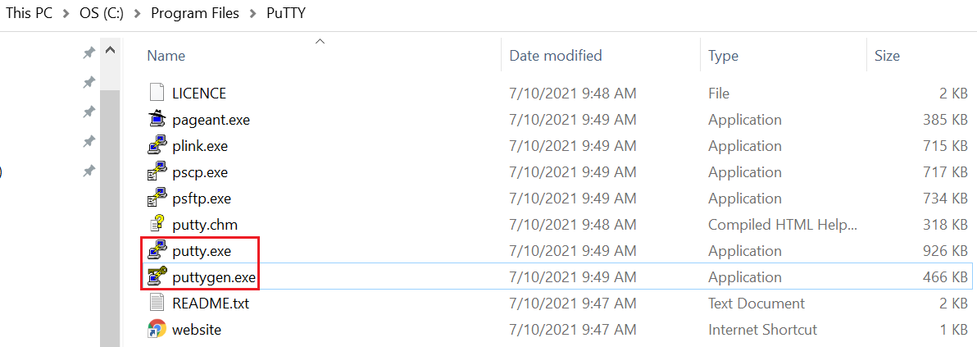
EC2 Service
Windows
https://www.chiark.greenend.org.uk/~sgtatham/putty/latest.html
Download Putty

Slide 11

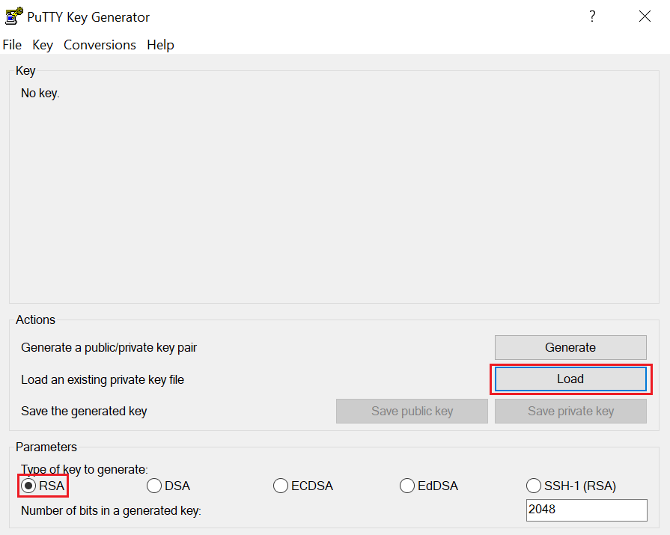
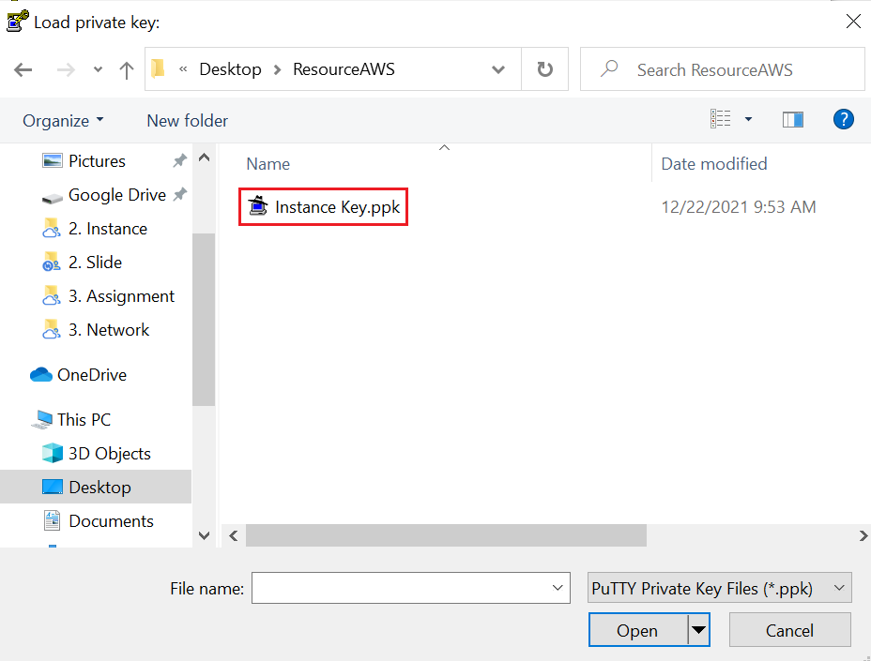
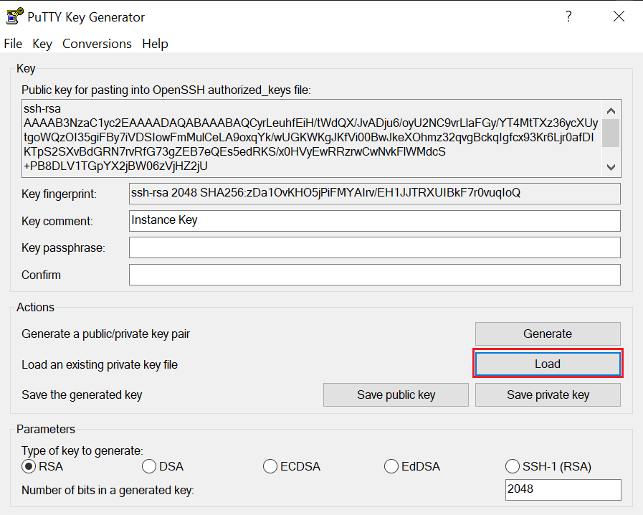
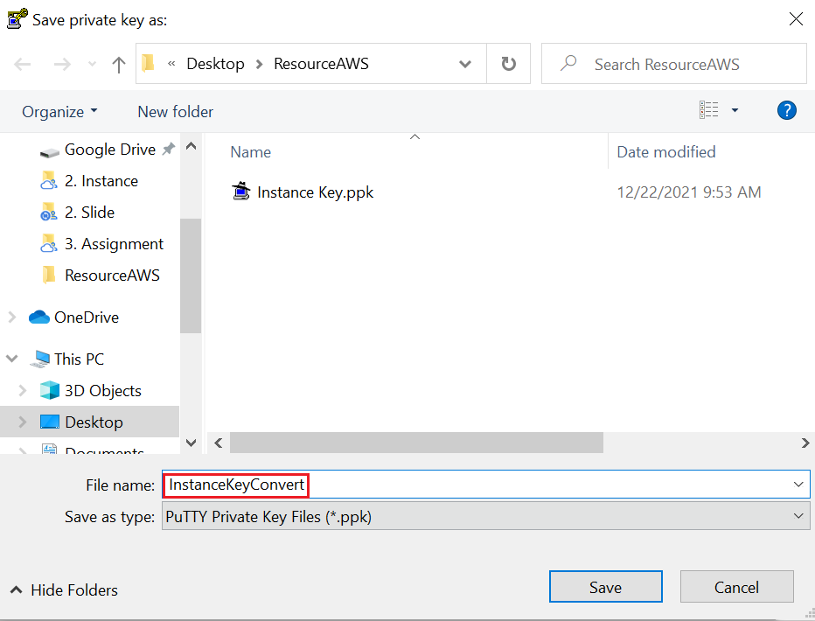
EC2 Service
Convert private key to Putty software format

Slide 12
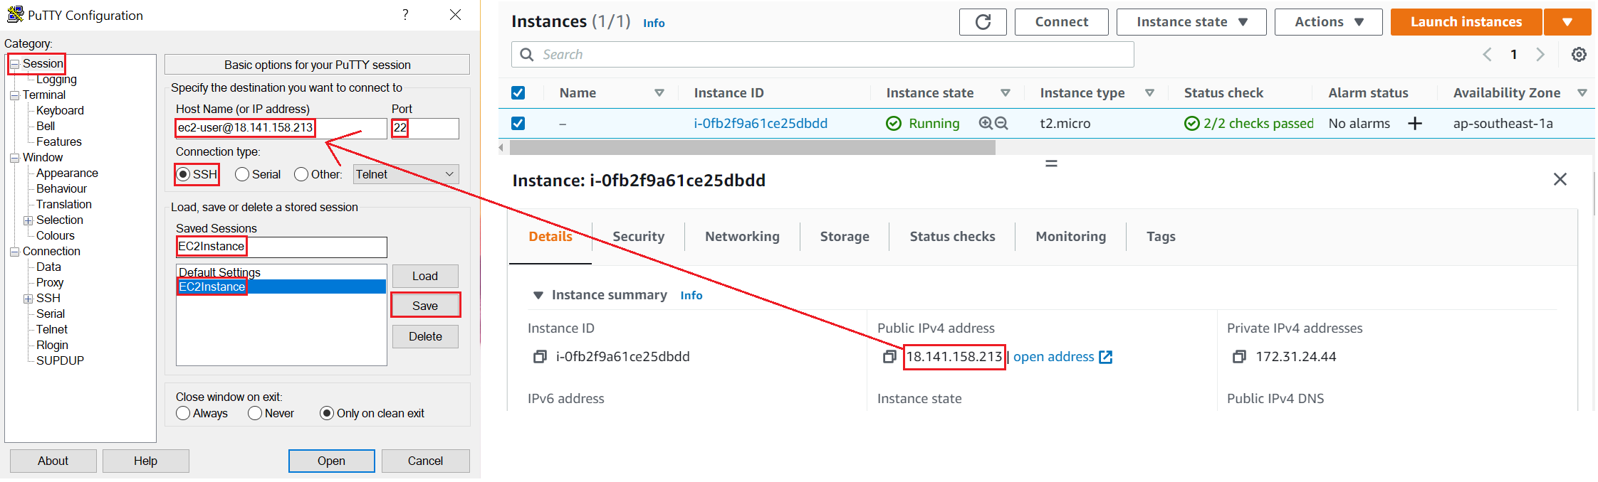

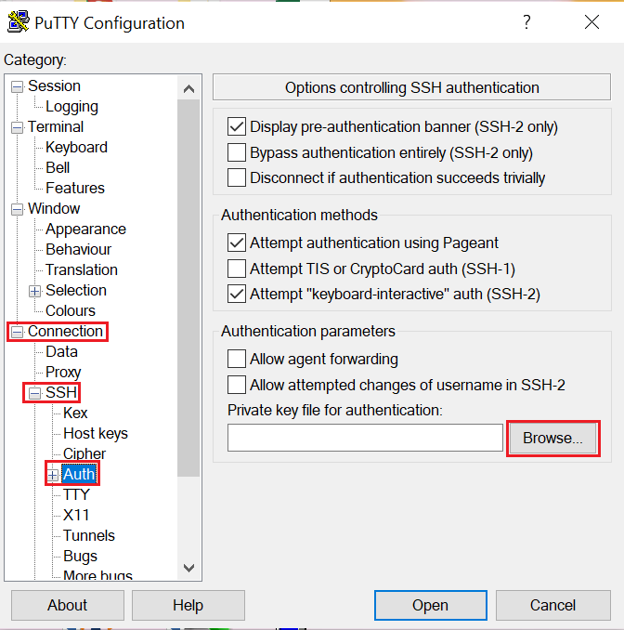
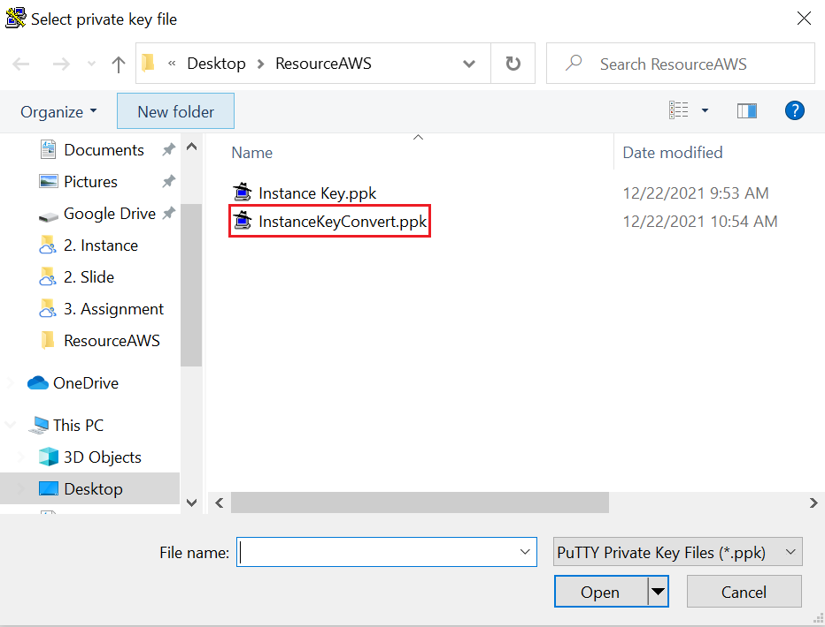
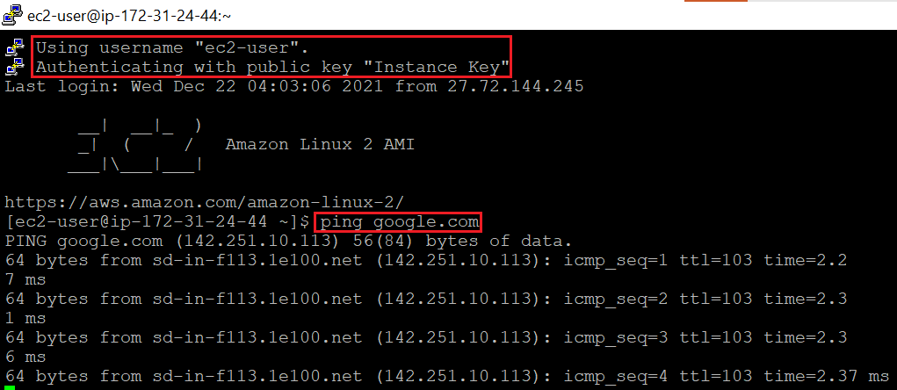
EC2 Service
Connect to EC2

Slide 13
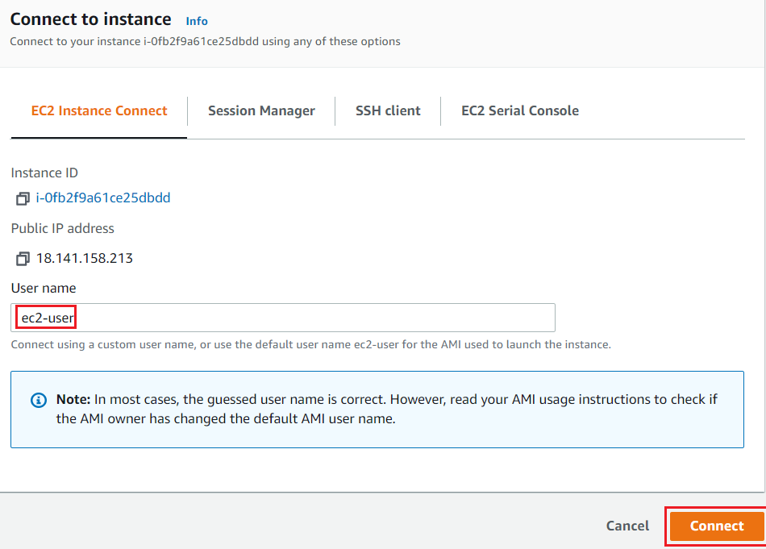
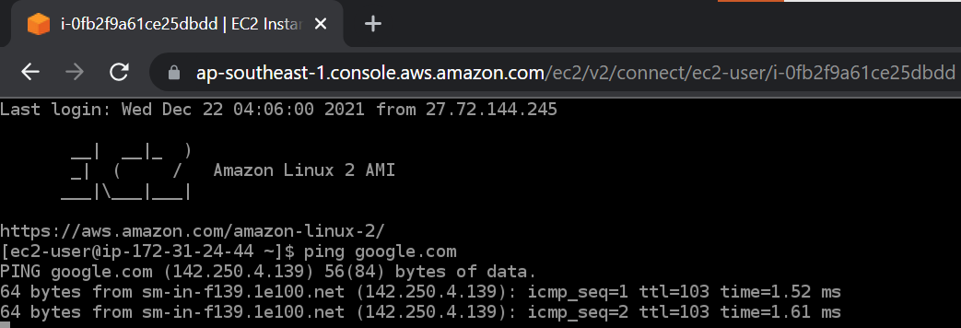
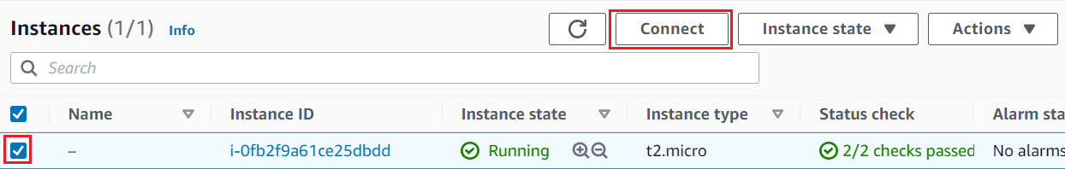
EC2 Service
Linux/Mac
https://www.youtube.com/watch?v=8UqtMcX_kg0
EC2 Instance Connect
No Need Private Key

Slide 14
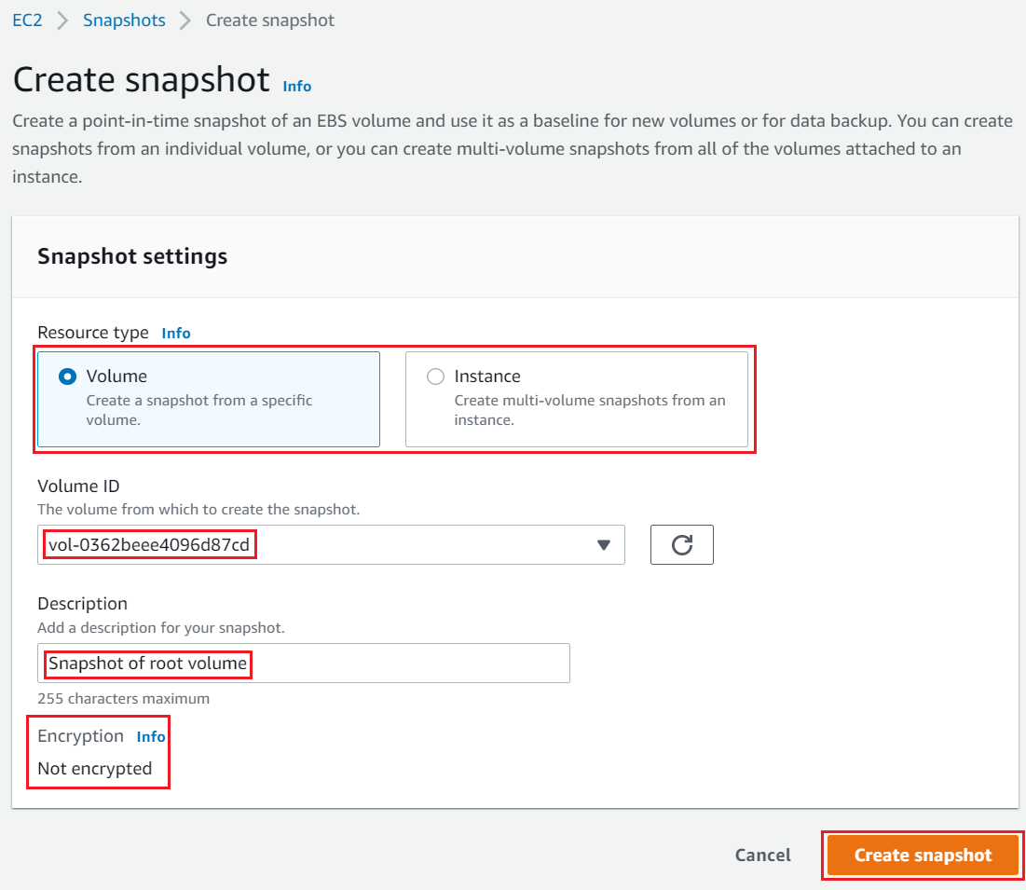
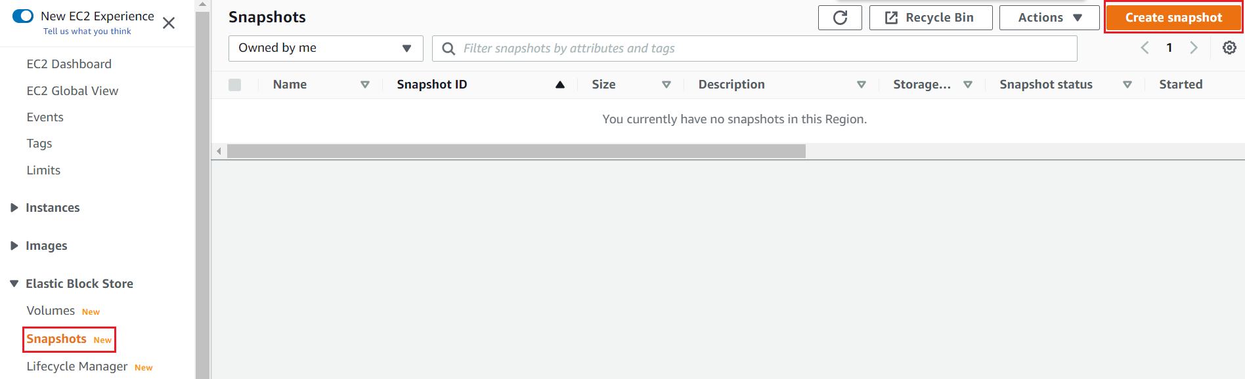
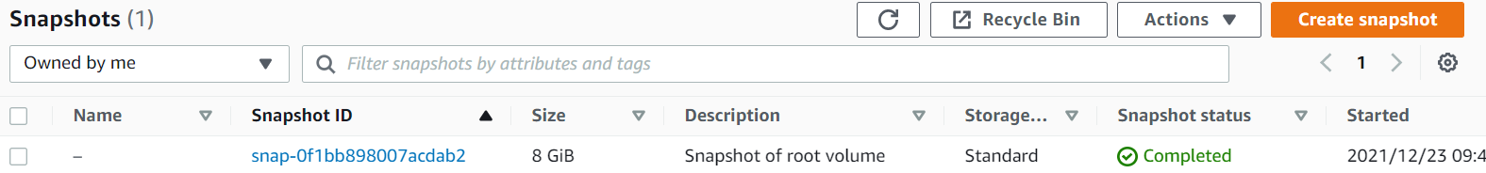
EC2 Service
Create Snapshot
Create Snapshot

Slide 15
Assignment
Self-practice

Slide 16
EC2 Service
Component
AMI
Instance
Fleet

Slide 17
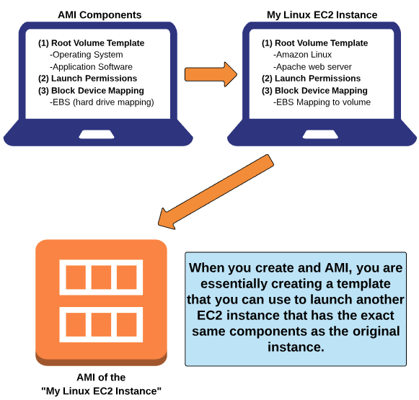
EC2 Service
AMI (Amazon Machine Image)
Provide a template to launch instances (Similar to computer ghost with both operating system, data, configuration, other software, ...)
Regional resource
Include
Root Volume Template
Launch permissions
Block Device Mapping: EBS/Instance Store

Slide 18
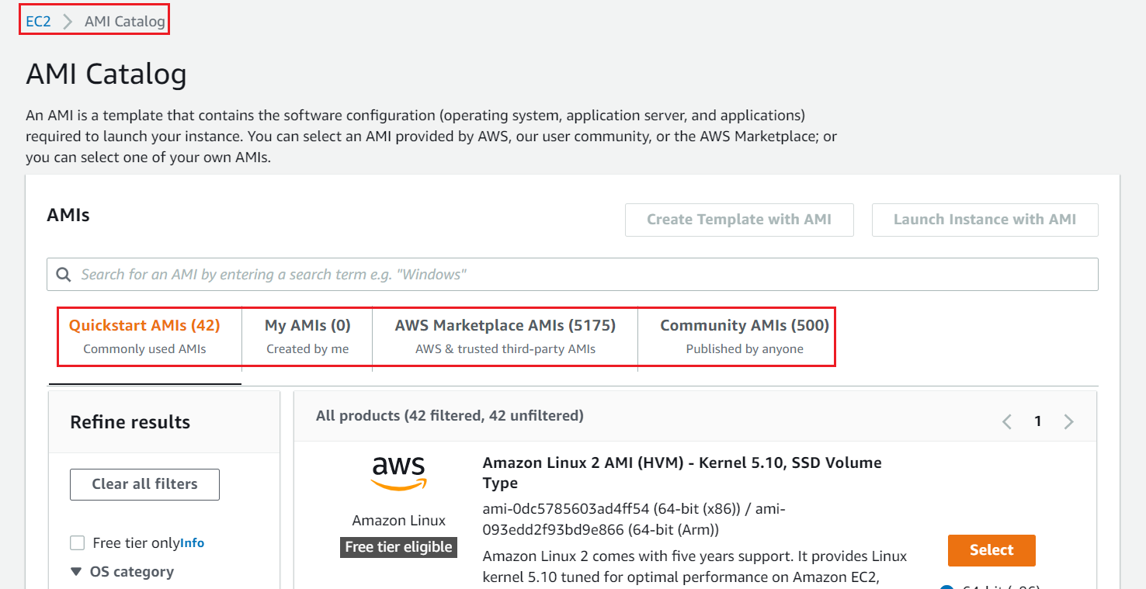
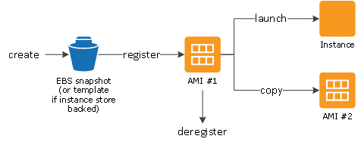
EC2 Service
3 types:
Community AMIs: free
AWS Marketplace AMIs: pay to use
My AMIs
AMI is launched from EBS snapshots

Slide 19
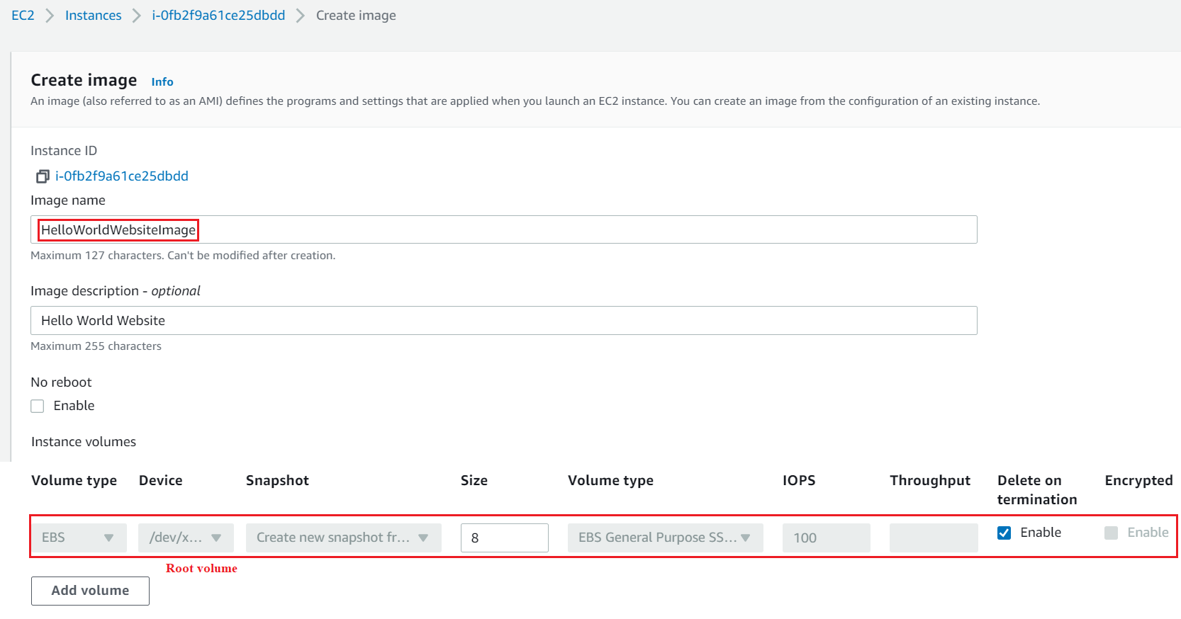
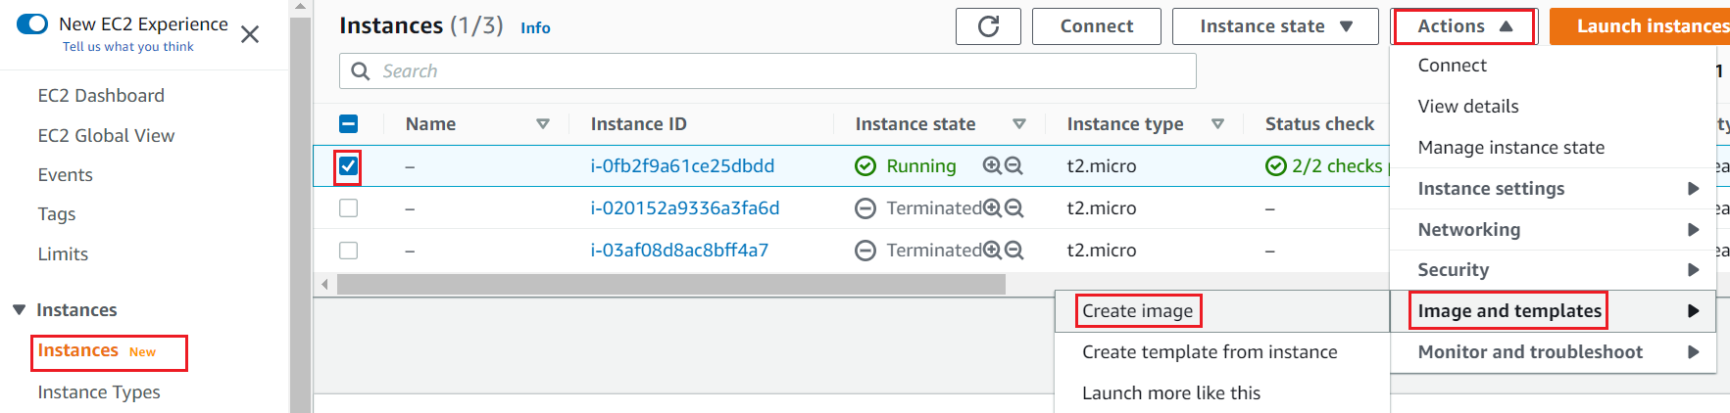
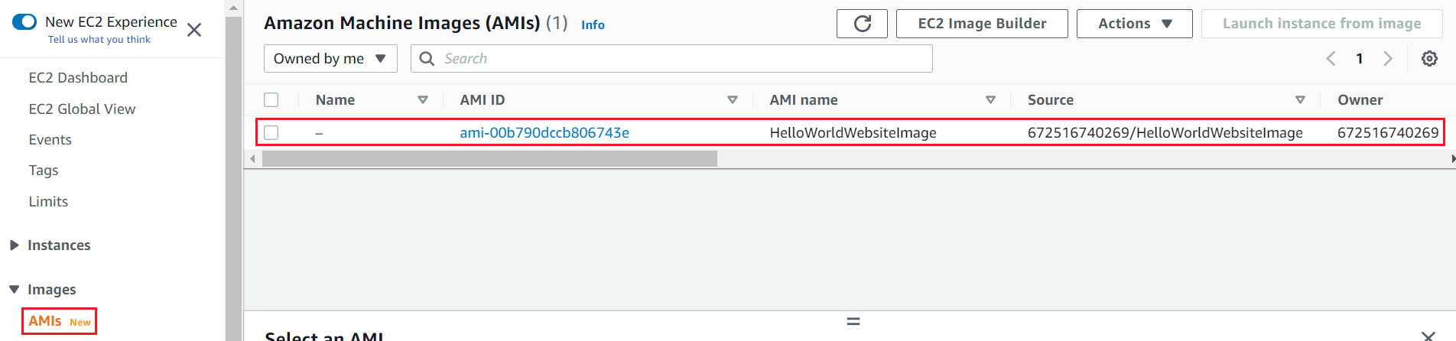
EC2 Service
Demo
Create AMI
Launch new Instance from that AMI
Test
Create AMI

Slide 20
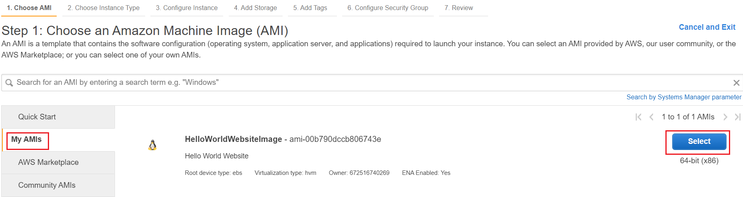
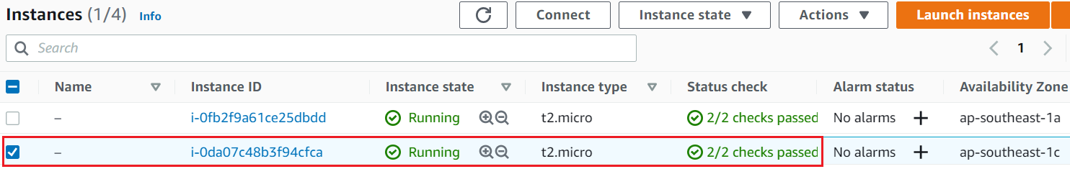
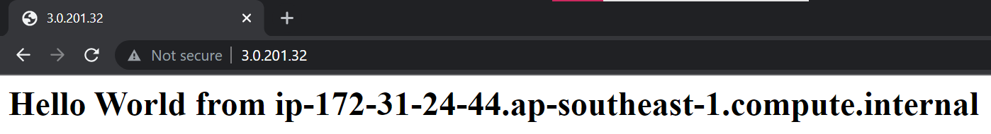
EC2 Service
Launch new Instance from that AMI
Test

Slide 21
Assignment
Self-practice

Slide 22
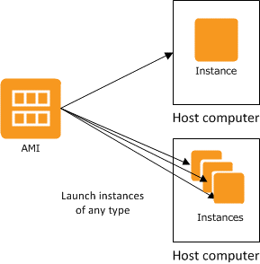
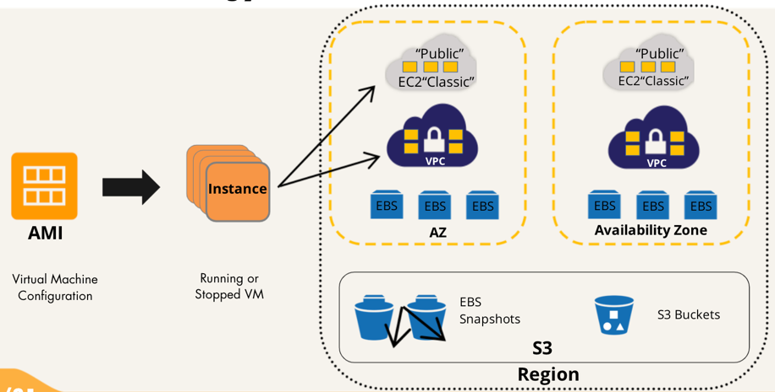
EC2 Service
Instance
Is a virtual server in cloud, launched from the AMI template
Instances will be run on resources independent of physical host resources (Similar to virtual machines on your computer)
CPU, Ram, Virtual storage
Network (VPC)
Zone resource
Components: Instance type, Storage, Network, Security group, Lifecycle, User Data, ...
Available user: ec2-user
Can launch 1 or more instances from 1 AMI template

Slide 23

EC2 Service
Instance type
Specific hardware (RAM, CPU, Storage, Networking) for instance
Console

Slide 24


EC2 Service
Types:
General Purpose
Compute Optimized
Accelerated Computing
Memory Optimized
Storage Optimized
https://aws.amazon.com/ec2/instance-types/

Slide 25


EC2 Service
Structure
Can resize instance type (must stop instance)

Slide 26

EC2 Service
Instance purchasing options:
On-demand instances
Spot instances
Savings plan instances
Reserved instances
Dedicated hosts
Dedicated Instances
https://docs.aws.amazon.com/AWSEC2/latest/UserGuide/instance-purchasing-options.html

Slide 27
EC2 Service
On-demand instances
Expensive, cannot be interrupted
Pay as you go, pay by hour (second)
No commitment, without any up-front payment
Can resize instance type
Suitable for app with unpredictable workloads, short time, during dev or test
Spot instances
Reducing the cost up to 90%, can be interrupted anytime
Auction EC2 instance which is free
Notice 2 minutes in advance and revoke the instance
Suitable for: data analysis, batch jobs, background processing, optional tasks
Strategies
capacityOptimized
Diversified
lowestPrice
instancePoolsToUseCount

Slide 28
EC2 Service
Reserved instances
Reducing the cost up to 70%, cannot be interrupted
Commitment with instance type & region for one or three years (receive discounted pricing across your resources)
Suitable for app with predictable workloads, long time, apps during production
Types
Standard reserved: Can not resize instance type
Convertible reserved: Can resize instance type
Schedule reserved: After purchase, you can configure the time to turn on the instance
Payment options: All Upfront, Partial Upfront, No Upfront
Savings plan instances
Reducing the cost up to 72%, cannot be interrupted
Commitment for one or three years (receive discounted pricing across your resources)
Can resize instance type
Suitable for app with predictable workloads, long time, apps during production
2 types
Compute Savings Plans: More flexible, less discount (up to 66%)
EC2 Instance Savings Plans: More discount (up to 72%)

Slide 29

EC2 Service
Dedicated Hosts
Expensive, cannot be interrupted
Physical EC2 server dedicated for your use (EC2-server)
Order configuration hardware, software licenses on request
Suitable for app that do not support virtual machines
3 types
On-Demand Dedicated Hosts
Dedicated Host Reservations
Savings Plans
Dedicated Instances
Similar to Dedicated Hosts but run in VPC

Slide 30

EC2 Service
Price

Slide 31

EC2 Service
Best Practices:
Should run the app with minimal configuration with on-demand instances or stable instances and add additional spot instances
Can resize instance type when instance stop (https://docs.aws.amazon.com/AWSEC2/latest/UserGuide/ec2-instance-resize.html)
Can move instance to another zone, another region (Create AMI from running instance 🡺 Launch new Instance from that AMI in other region, other zone)
Checking the instance is suitable: https://docs.aws.amazon.com/AWSEC2/latest/UserGuide/ec2-instance-recommendations.html
Price: https://aws.amazon.com/ec2/pricing

Slide 32
Assignment
Self-practice

Slide 33

EC2 Service
Storage
Types:
Amazon EC2 Instance Storage
Amazon Elastic Block Store (EBS)
File storage: Amazon EFS, Amazon FSx, S3 (Next Lesson)

Slide 34


EC2 Service
Block Device Mapping
Can add more storages into instance
Mapping volume to folder into instance

Slide 35


EC2 Service
Amazon EC2 Instance Storage
Local storage
Is the physical device in the host computer
When instance stop, restart, hibernate, terminated, data will be lost (reboot will still save data)
Cannot detach volume and attach to other instance
Cannot add more instance storage when the device is starting
Usecases: OS, temporary data (buffers, caches, ...)

Slide 36


EC2 Service
Very high IOPS (input/output operations per second)
2 types: HDD, NVMe SSD
Very high IOPS
Some instance types only support EBS volumes

Slide 37

EC2 Service
Amazon Elastic Block Store (EBS)
Is a hard drive in the cloud (Similar to USB device)
When instance stop, restart, hibernate, terminated, data will still available
Network drive 🡺 a bit of latency
Can attach multiple EBS to 1 instance, but EBS only attaches to 1 instance at a time
Have a provisioned capacity (size in GBs, and IOPS)
Zone resource
Usecases: long-term data, important data (Ex: image, ...)

Slide 38

EC2 Service
Types:
Provisioned IOPS SSD
General Purpose SSD
Throughput Optimized HDD
Cold HDD
Magnetic
You can increase the capacity of the drive over time
https://aws.amazon.com/ebs/pricing/
https://docs.aws.amazon.com/AWSEC2/latest/UserGuide/ebs-volume-types.html

Slide 39


EC2 Service
Burst IOPS
In a short time, EBS can burst IOPS up (Ex: 100 🡪 3000 in 30 minutes)
https://docs.aws.amazon.com/AWSEC2/latest/UserGuide/ebs-volume-types.html#EBSVolumeTypes_gp2

Slide 40

EC2 Service
Encrypt volume (at-rest)
You must be set up Encrypt Volume when Instance creating
Encryption and decryption are handled transparently (you have nothing to do)
Encryption has a minimal impact on latency
Convert unencrypted volume 🡺 encrypt volume: Create an snapshot of the volume 🡪 Encrypt the snapshot 🡪 Create new encrypt volume from the snapshot 🡪 attach the encrypted volume to the original instance
Delete on Termination
Delete EBS when deleting instance (Default: Root: enabled, additional EBS: disabled)

Slide 41


EC2 Service
EBS-optimized (Optional)
Improved performance for EBS volumes and enables instances to use provisioned IOPs fully, automatically enable
Lifecycle
EBS-optimized
Lifecycle
Detach volume
Must unmount & stop instance before detaching root volume
Can unmount & detach the additional volume without stopping the instance

Slide 42

EC2 Service
Snapshot
Similar to backup of EBS volume
Can copy, share snapshot, public snapshot, encrypt snapshot
Store in S3
Make snapshot at a point in time (Real-time creating), Data into snapshot is lazy loading
Should (not must) stop instance before creating snapshot
Snapshots of encrypted volumes are encrypted
Usecases: Copy EBS to new zone or new region, backup EBS for accident, create AMI
AMI is launched from EBS snapshots
Copy EBS to new zone, region

Slide 43


EC2 Service
Incremental
Total 12GB

Slide 44


EC2 Service
Creating snapshot types
Manual
Using Amazon Data Lifecycle Manager to automatic create, delete snapshot
Using Lifecycle Manager
Manual

Slide 45
EC2 Service
Root storage (root device)
When bootstrapping EC2 from AMI, a root storage is created for the instance
2 types: EBS, Instance store

Slide 46
EC2 Service
Demo
Create EBS volume
Attach volume to Instance & Mount volume to instance
Create Snapshot manually 🡪 restore instance, create AMI from snapshot
Create Snapshot using Lifecycle Manager

Slide 47



EC2 Service
Create EBS Volume
Attach volume to instance

Slide 48


EC2 Service
Result
Mount volume to instance

Slide 49


EC2 Service
Create Snapshot manually

Slide 50


EC2 Service
Run new instance 🡺 Mount volume to instance
Restore instance

Slide 51

EC2 Service
Create AMI from snapshot

Slide 52

EC2 Service
Create Snapshot using Lifecycle Manager

Slide 53
Assignment
Self-practice

Slide 54

EC2 Service
Network
The instance will be run in a VPC (virtual network) to separate infrastructure from workload
Traffic in the region with bandwidth up to 100Gbps, out of region maximum up to 5Gbps
Ipv4 & Ipv6
IPv4 is still the most common format used online.
IPv6 is newer and solves problems for the Internet of Things (IoT)

Slide 55

EC2 Service
Public Ipv4 & Private Ipv4
https://whatismyipaddress.com

Slide 56
EC2 Service
Network card
Is a virtual network card
Can attach, detach from instance, assign to many other instances
Each instance can attach multiple Network Cards
Types: VF, ENI, ENA, EFA

Slide 57
EC2 Service
VF (Virtual Function)
Old, Use for old instances
Speed up to 10 Gbps
ENI (Elastic Network interface) (Default)
Is a virtual network card, provided by default for instance
Each instance will have only a primary network interface and can have multiple second network interfaces
Each network interface is assigned to a subnet (when attaching an instance to a network interface will assign IP for instance)

Slide 58

EC2 Service
Each network interface will be allocated to the instance:
1 primary private Ipv4 and 1 private DNS hostname (Using for instance in VPC communication)
Multiple secondary private Ipv4
1 Elastic IP per private Ipv4 (optional)
1 public Ipv4 (optional) and 1 public DNS hostname (optional) (Using for internet communication)
Multiple Ipv6 (optional)
Mac address
Multiple Security groups
By default, IPv4 will be used

Slide 59
EC2 Service
ENA (Elastic Network Adapter)
Performance is better than ENI
High network requirements (download, upload high speed)
EFA (Elastic Fabric Adapter)
Is a physical device attached to EC2 that allows access to high performance computing (HPC) (Ex: machine learning)
Speeds up to 100 Gbps
Not support windows instances

Slide 60


EC2 Service
Demo
Create ENI
Attach ENI to Instance
Create ENI

Slide 61



EC2 Service
Attach ENI to Instance
Result

Slide 62
EC2 Service
Features
Enhanced networking
Elastic IP
Placement group

Slide 63
EC2 Service
Enhanced networking
Is an instance function, supports faster network access
Almost all instances support Enhanced networking
Provide
Higher bandwidth
Higher packet per second (PPS) performance 🡺 less jiter
Free

Slide 64
EC2 Service
Elastic IP
When you stop and then start an EC2 instance, it can change its public IP 🡺 change code 🡺 Using Elastic IP to fixed public IP for instance
Attach Elastic IP to one instance at a time
Overall, try to avoid using Elastic IP:
They often reflect poor architectural decisions
Instead, use a random public IP and register a DNS name to it
You can choose Ipv4 from AWS or your own IP
Max: 5 Elastic IP per region
Price: If you don't use it, you will lose money - https://aws.amazon.com/ec2/pricing/on-demand/

Slide 65
EC2 Service
Demo
Restart Instance
Attach Elastic IP to Instance
Test

Slide 66


EC2 Service
Restart Instance
Stop 🡪 Start again instance

Slide 67




EC2 Service
Attach Elastic IP to Instance

Slide 68
EC2 Service
Placement group
When running the instance, by default AWS will spread out to different hardware 🡺 network bandwidth will decrease 🡺 Using Placement group to increase network performance
Types:
Cluster placement group
Partition placement group
Spread Placement Group
Free

Slide 69


EC2 Service
Cluster placement group
When starting multiple instances, AWS will launch on the same zone 🡺 Instances will connect to each other faster
Usecases: Big Data job that needs to complete fast, Apps exchange with each other with high network performance
Partition placement group
Instance is initialized on multiple partitions and divided into different hardware (make sure each partition is not on the same hardware)
Usecases: Big Data, Large distributed and replicated workloads (Ex: Hadoop, Cassandra, Kafka)
Cluster
Partition placement group

Slide 70

EC2 Service
Spread Placement Group
Launch instances on separate hardware (network, power), AZ
Usecases: Application that needs to maximize high availability, Critical Applications

Slide 71
EC2 Service
Note
Can't merge placement groups
A instance only launches on a placement group at a time
Can't launch dedicated host in placement group
Demo
Create Placement group
Init new instances

Slide 72




EC2 Service
Create Placement group
Result
Init new instances

Slide 73
Assignment
Self-practice

Slide 74

EC2 Service
Security group
Define rules for inbound traffic & outbound traffic entering the instance (Similar to firewall)
Default: block all inbound traffic & allow all outbound traffic
Support allow rules (whitelist), not support block rules (blacklist)
Can be attached to multiple instances

Slide 75


EC2 Service
They regulate:
Access to Ports
Authorised IP ranges – IPv4 and IPv6
Control of inbound network (from other to the instance)
Control of outbound network (from the instance to other)
Ipv4

Slide 76
EC2 Service
Port to know:
22 = SSH (Secure Shell) – log into a Linux instance
3389 = RDP (Remote Desktop Protocol) – log into a Windows instance
21 = FTP (File Transfer Protocol) – upload files into a file share
22 = SFTP (Secure File Transfer Protocol) – upload files using SSH
80 = HTTP – access unsecured websites
443 = HTTPS – access secured websites

Slide 77


EC2 Service
Stateful: return traffic is automatically allowed, regardless of any rules
Detail Information

Slide 78



EC2 Service
Demo
Remove HTTP with port 80

Slide 79
Assignment
Self-practice

Slide 80


EC2 Service
Lifecycle
Start
Stop
Reboot
Hibernate
Terminate
Instances in Running state will be charged
Hibernate

Slide 81

EC2 Service

Slide 82
EC2 Service
EC2 User Data Script (Bootstrap script)
The code to be run when instance launch (That script is only run once at the instance first start)
Usecases: Installing updates OS, Installing software, Downloading common files from the internet, ...

Slide 83
EC2 Service
Other config for instance
Insert, update, delete account in instance (https://docs.aws.amazon.com/AWSEC2/latest/UserGuide/managing-users.html)
Config timezone in instance
Set hostname & DNS for instance
Monitoring instance (https://docs.aws.amazon.com/AWSEC2/latest/UserGuide/monitoring_ec2.html)
Import/export between on-premises and EC2 (https://aws.amazon.com/ec2/vm-import)

Slide 84

EC2 Service
Connect to Instance
SSH
RDP
AWS Systems Manager Session Manager (Self-study)
AWS Systems Manager Run Command (Self-study)

Slide 85

EC2 Service
Fleet
Used to run a group of instances
Support instance purchasing options: On-Demand, Reserved and Spot Instance
Only support CLI, API

Slide 86


EC2 Service
Demo
https://docs.aws.amazon.com/AWSEC2/latest/UserGuide/ec2-fleet-instance-weighting-walkthrough.html

Slide 87
Summary
EC2 service provides hardwares (Ram, CPU, Storage), Network, OS System (Windows, Linux, Mac OS, ...), Software (SQL Server, ...), Firewall (Security Groups, ...), Bootstrap script, ...
AMI provides a template to launch instances, launched from EBS snapshots
Instance
Is a virtual server in cloud, independent of physical host resources
Instance type: specific hardware (RAM, CPU, Storage, Networking) for instance
Instance purchasing: On-demand, Spot, Savings plan, Reserved, Dedicated hosts, Dedicated Instances
Storage: EC2 Instance Storage, EBS (Block Device Mapping, network drive), Snapshot (S3, Incremental)

Slide 88
Summary
Network: run in VPC, Network card (VF, ENI, ENA, EFA), Features (Enhanced networking, Elastic IP, Placement group)
Security group: stateful, define rules for inbound traffic & outbound traffic entering the instance
Lifecycle: Start, Stop, Reboot, Hibernate, Terminate
User Data: The code to be run when instance launch
Available user: ec2-user
Connect to instance: SSH, RDP, Session Manager
Fleet: launch group of instances, only support CLI, API

Slide 89
Assignment

Slide 90
Quiz

Slide 91
Reference
https://docs.aws.amazon.com/

Slide 92
Q & A
Copyright © VTI Academy All Rights Reserved

